Slide 1
HBASE Consulting Sharing
Sharing of Insights
Bernard/Tan Peng/Yim Sio Kek(Jack)

Slide 2
Agenda
Hadoop HBASE Development Sharing
Quick Introduction to HBASE
HBASE Insights (Developers)
HBASE Design
HBASE Data Ingestion
HBASE Data Extraction
Consultation Take-away
Hadoop HBASE Admin Sharing

Slide 3
What is Apache HBase ™?
Apache HBase™ is the Hadoop database, a distributed, scalable, big data store.
Use Apache HBase™ when you need random, real-time read/write access to your Big Data.
https://hbase.apache.org/

Slide 4
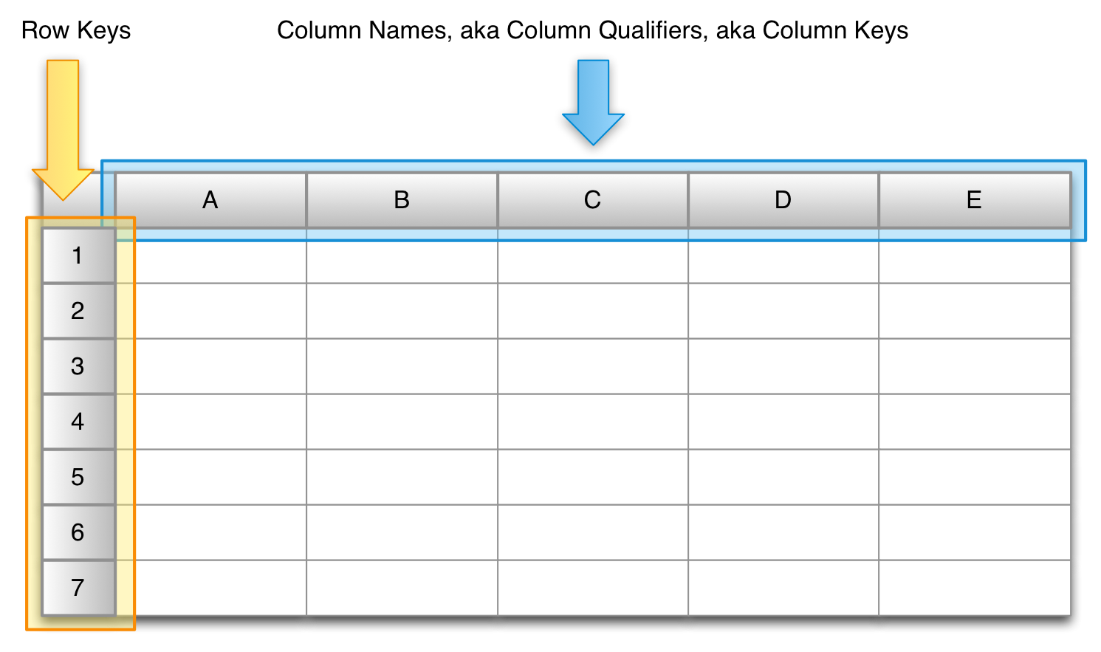
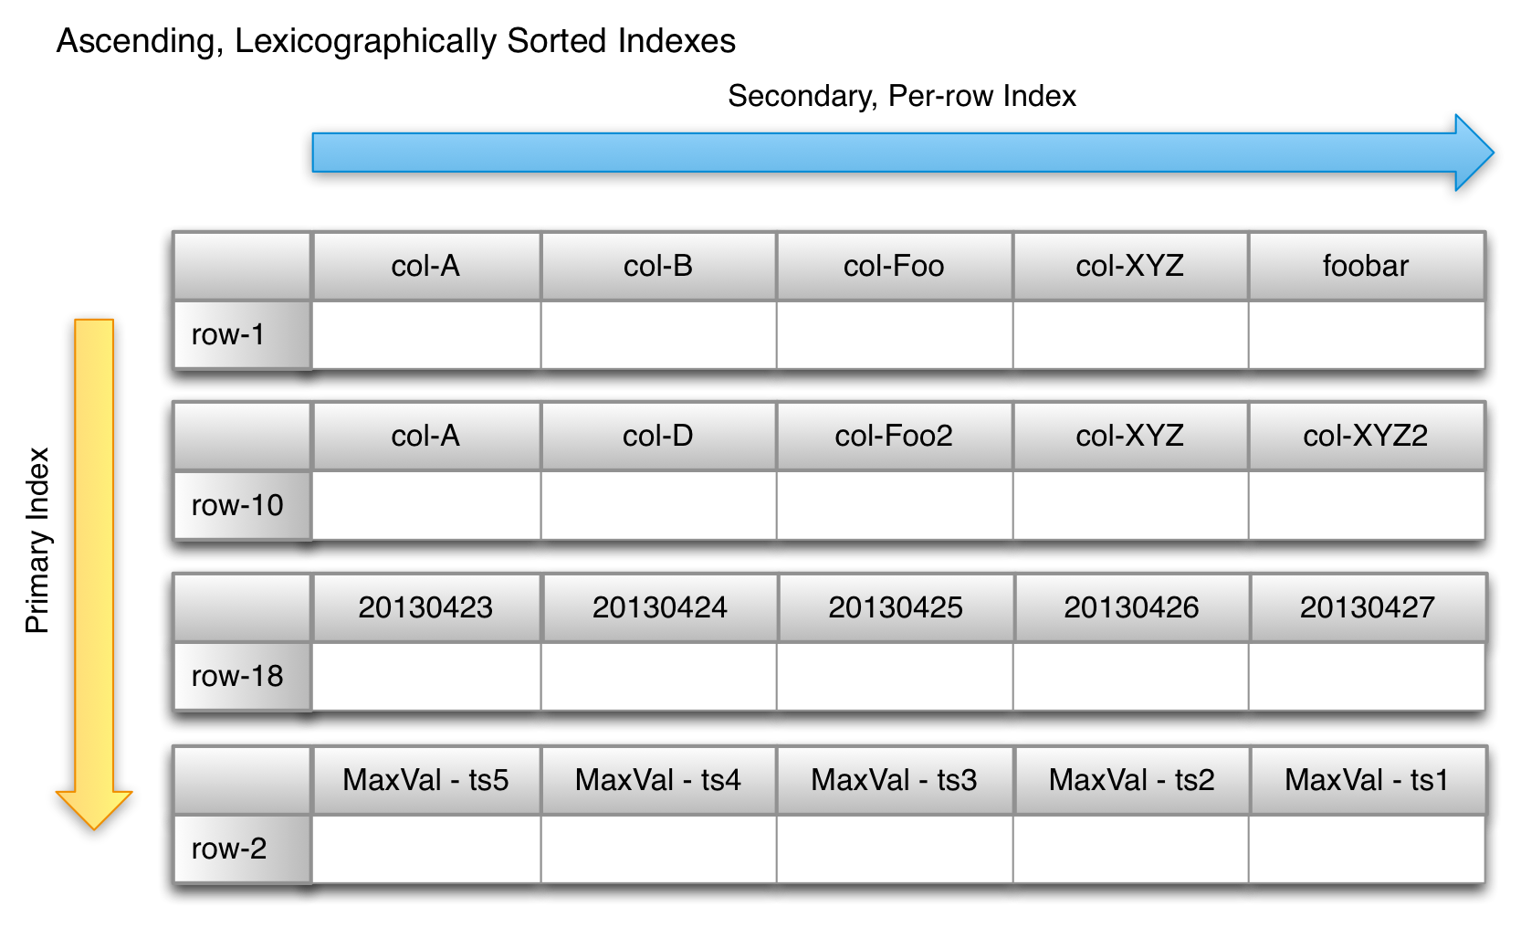
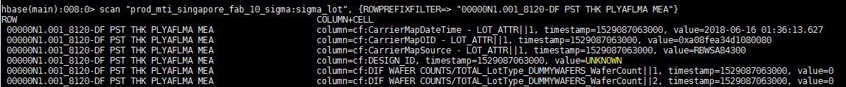
HBase Introduction
Row key
Column Family
Column Qualifiers
Timestamp
Cell
Value

Slide 5
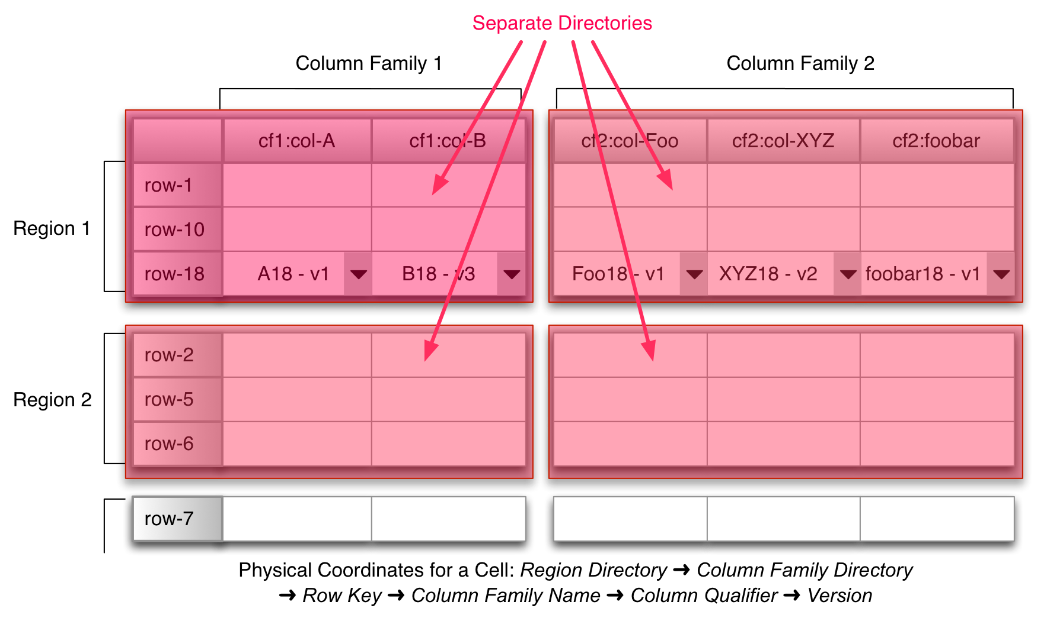
HBase Introduction
Row key
Column Family
Column Qualifiers
Timestamp
Cell
Value

Slide 6
HBASE Insights (Development)
HBase Design
HBase Data Ingestion
HBase Data Extraction
HBase Optimality (Developer)

Slide 7
HBASE Insights
(HBase Design)
HBase Design
HBase Data Ingestion
HBase Data Extraction
HBase Optimality (Developer)

Slide 8
HBASE Insights
HBASE Design
Different aspects of HBASE Design:
Business Use Case
Row Key
Column Qualifiers
Row Value
Number of Regions
Column Family
Encoding

Slide 9
Row key Design
Key Design is very important!
HBase can find a specific row very fast
HBase can find rows with a specific prefix pretty fast
HBase however is not the best for random lookups on random columns or parts of columns or the key
Make sure to look at your query patterns before you design a table
For row key, it suggests not to be long. It should not be more than 100KB.
By default total length of the cell (rowkey, column family, column qualifier, value, timestamp) maximum size is 10MB.

Slide 10
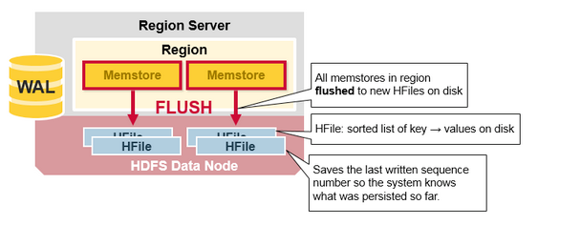
Column Families
For column family, the number should not be large. It suggests to be less than 10.
1 memstore control 1 column family. If there is too many column families and when memstore is full, it will result in a lot of HFiles during the flushing process at similar time. It will trigger frequent HFile compaction.

Slide 11

Column Qualifiers
Do we put one field into rowkey (long format table) or into column qualifier (wide format table)?
Assuming if one row occupies 1 GB of data.
HFile will be 1 GB.
Entire block of HFile will be loaded in-memory for scanning.
If you only require a small subset of the column qualifiers, then it is a waste.
If you need majority of the column qualifiers at a time, then it might be OK.
Understanding your business use case on how you want to query the data!
It depends

Slide 12
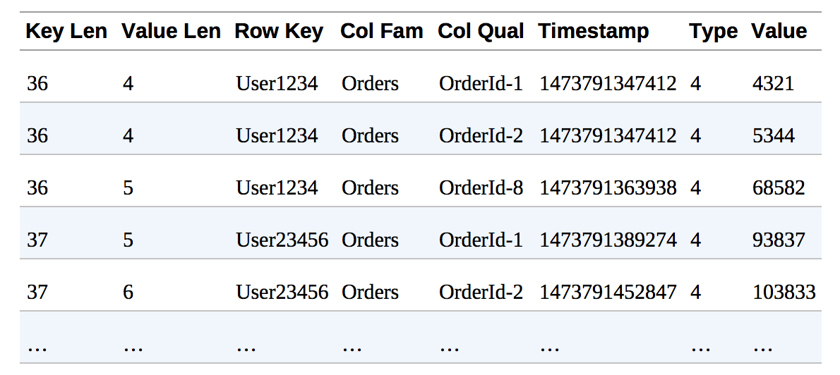
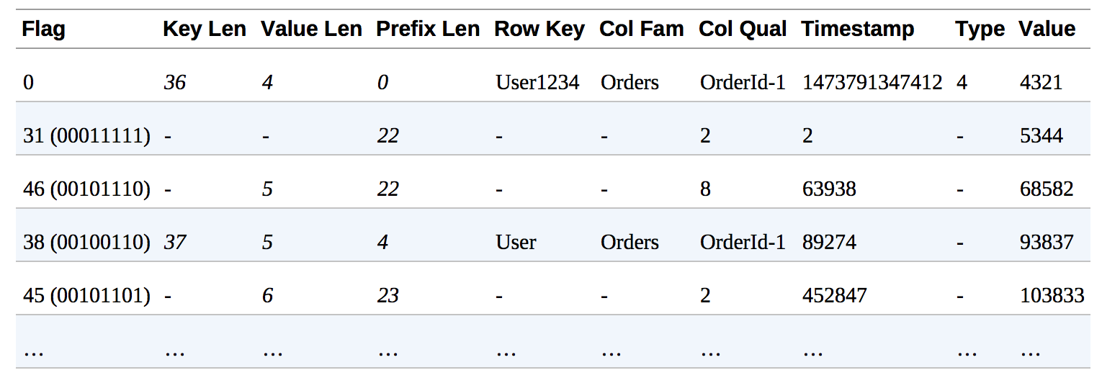
Enable DATA_BLOCK_ENCODING
Create Table
In HBASE, in a block, it can be configured encoding or not.
If DATA_BLOCK_ENCODING is not enabled, all information is stored in the block.
If DATA_BLOCK_ENCODING is enabled, only difference compared to previous cell is stored. This will reduce the size of space required.
Suggest to enable DATA_BLOCK_ENCODING by default when create new tables.
DATA_BLOCK_ENCODING is not Enabled
DATA_BLOCK_ENCODING is Enabled

Slide 13
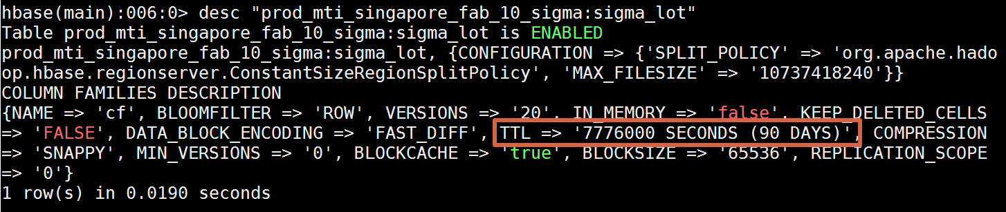
Data Retention
Create Table
Configure meaningful timestamp
Set Time-to-live(TTL) if appropriate

Slide 14
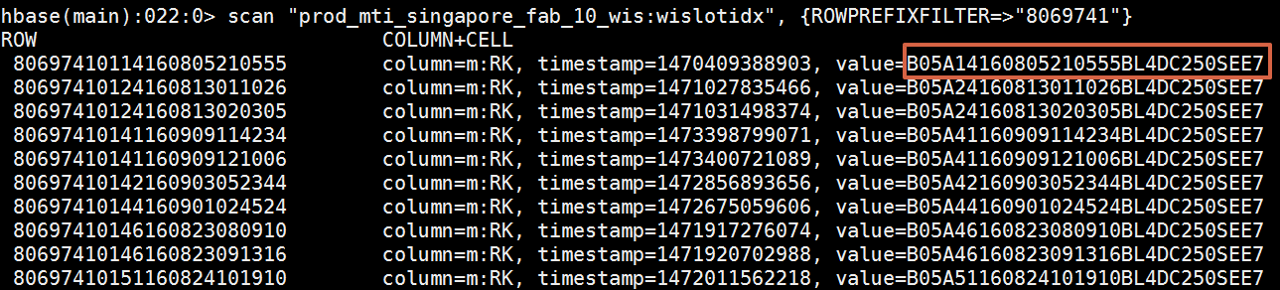
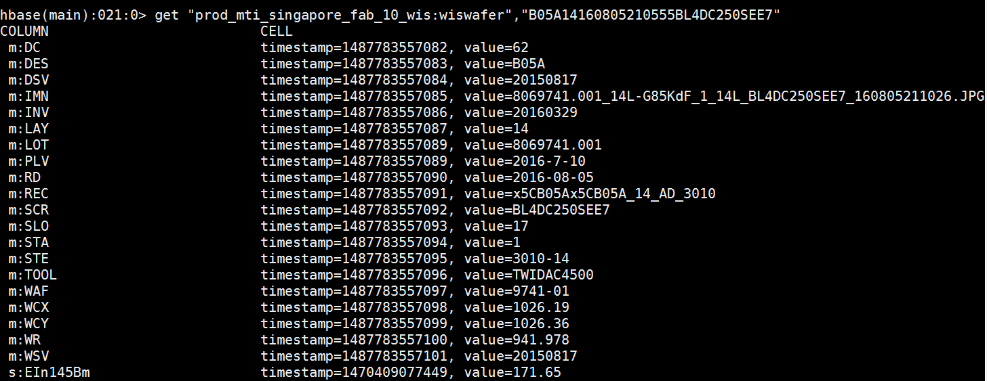
Generic design for different business use cases?
Might require multiple copies for different use-cases.
If required information is available in the HBase and row key design requirement is different:
Create indexing HBase table based on requirements, like time index or step index. [Not Recommended]
Search indexing HBase table and find row key first and then query by row key.
Multiple indexing table created for different indexing requirements
Search by lot
Search by time

Slide 15

Table Schema Design
Create Table
The use of Solr is to build index/lookup table to prevent unnecessary dependency on HBase and avoid unnecessary hit to HBase.
The use case is cater different query pattern for same HBase Table.
Based on the field provided to Solr, it can return corresponding rowkey.

Slide 16
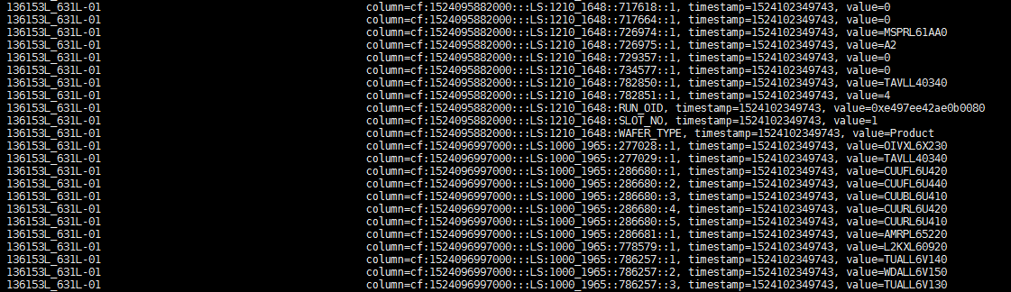
Sigma HBase Table Redesign
Old Schema Design
ROW KEY : LOT_ID_WAFER_ID
COLUMN FAMILY: cf
COLUMN QUALIFIER: EPOC + “:::LS:” + MFG_PROCESS_STEP_INDEX + “::” + COMMON_TEST_ID + “::” + ITEM_SEQ_NO
COLUMN VALUE: TEST VALUE
TIMESTAMP: HBase insert record time

Slide 17
Sigma HBase Table Redesign
Sigma HBase Table – Old Schema
Schema Design
This design is intended to query all steps’ signal value by a cut-off time. That is why epoc time is put at the beginning of column qualifier.
Pros | Cons
Epoc time is put as the beginning of column qualifier. Easier filtering by time. | Not optimal to query by MFG_PROCESS_STEP(Probe Auto Diagnostic and MicA use case.)
 | In order to filtering by signal name, all column data has to download from HBase first and then do the filter. Not memory efficient.
 | Need to read index table first to convert MFG_PROCESS_STEP_INDEX to actual MFG_PROCESS_STEP.

Slide 18
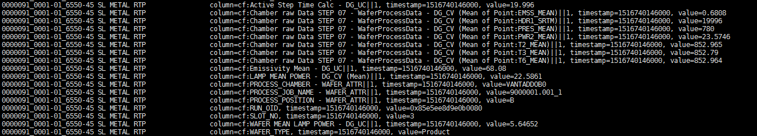
Sigma HBase Table Redesign Test
New Schema Design
ROW KEY : LOT_ID_WAFER_ID_ MFG_PROCESS_STEP
COLUMN FAMILY: cf
COLUMN QUALIFIER: COMMON_TEST_ID||ITEM_SEQ_NO
COLUMN VALUE: TEST VALUE
TIMESTAMP: RUN_COMPLETE_DATETIME

Slide 19
Comparison Result
Old schema versus new schema query speed
TTMY48 Query Test Cases:
To query 2359 lots same required data:
Old schema: > 30 min
New schema: ~ 5min
Inline Auto Diagnostics Test Cases:
To query ~2359 wafers same required data:
Old schema: > 2 hours
New schema: ~ 6 min

Slide 20
HBASE Insights
(HBase Design)
HBase Design
HBase Data Ingestion
HBase Data Extraction
HBase Optimality (Developer)

Slide 21
Data Query from HBase
Data Query
When we use HBase API to do the query, we need to apply new version of API. HBase connection API is changed in recent 1.x version. Old connection API is expected to retired in 2.x version.
Name | Old Type | Replacement | New Type
HTable | Class | Table | Interface
HTable | Class | RegionLocator | Interfafce
Htable.setAutoFlush(false) | Method | BufferedMutator | Interface
HConnection | Interface | Connection | Interface
HConnectionManager | Class | ConnectionFactory | Class
HTableFactory | Class | ConnectionFactory.createConnection() | Method
HTableInterface | Interface | Table | Interface
HTablePool | Class | Connection.getTable() | Method
<tablename> | String | TableName | Class
HBaseAdmin | Class | Admin | Interface

Slide 22
Data Query from HBase
Data Query
Example Code for HBase Create Connection:
Close the connection when connection no need anymore.
Configuration conf = HBaseConfiguration.create();
Connection connection = ConnectionFactory.createConnection(conf);
TableName tableName = TableName.valueOf("testtable");
Table table = connection.getTable(tableName);
...
...
Result result = table.get(get);
...
...
table.close();
connection.close();

Slide 23
Data Query from HBase
Data Query
To limit the size of query, below two methods are available.
setCaching(int)
Set the number of rows for caching that will be passed to scanners.
setMaxResultSize(long)
Set the maximum result size.
Instead of setCaching(int),better to use setMaxResultSize(long), Or use its default (2MB)
You never know how much memory X rows will use so it's better to base it on a size.
Each call to next() will retrieve at most "maxResultSize" bytes worth of data.

Slide 24
Data Filtering in HBase
Data Query
Timestamp can be used as filter.
If Column A = Value B is desired filter, apply SingleColumnValueFilter.
If Regex filter is necessary, think twice. Try to avoid it by using other filters or apply Solr. Custom filter or comparator is also possible.
If multiple prefix filter are necessary, use MultiColumnPrefixFilter.
Queries only take a single Filter object! If multiple filters are necessary, use FilterList and set this FilterList as filter for Scan object.

Slide 25
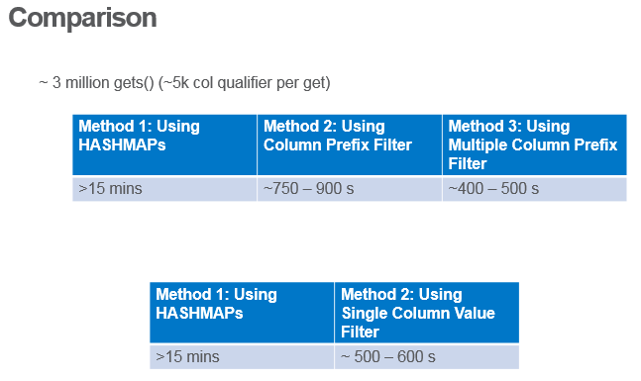
Data Filtering in HBase
Data Query
If multiple prefix filter are necessary, use MultiColumnPrefixFilter.
If Column A = Value B is desired filter, apply SingleColumnValueFilter.

Slide 26
HBASE Insights
(HBase Design)
HBase Design
HBase Data Ingestion
HBase Data Extraction
HBase Optimality (Developer)

Slide 27
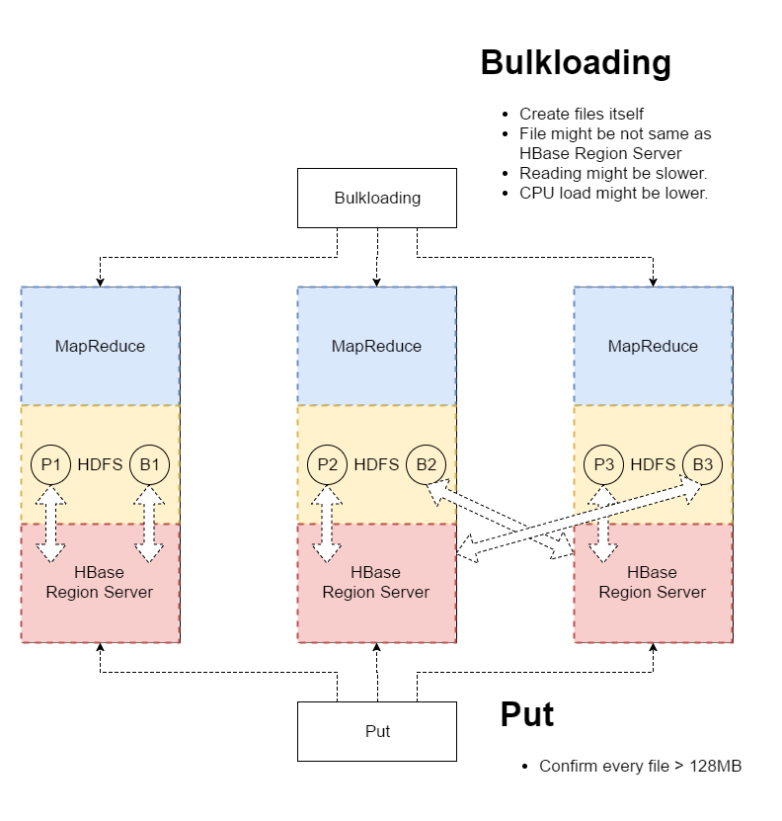
Use Put or Bulkloading?
Data Ingestion
When adding data into HBase, two methods are commonly used.
In HBase, region server will start to compact HFiles if default number of HFiles are reached (eg. 10). Generating too many small files will cause region server to continuing compacting HFiles.
Bulk Loading vs Put
Use PUT when per ingest is <=128MB per region server
Bulk Loading comes with side effect of hitting into data locality issue
Bulk Loading issue: JIRA Link

Slide 28
Use one Put for all columns
Data Ingestion
When using PUT, add all columns’ value first and put all columns’ data once. Do not put cell by cell. This can avoid the waiting time between puts.
Put put = new Put(Bytes.toBytes("row1"));
put.addColumn(Bytes.toBytes("colfam1"), Bytes.toBytes("qual1"), Bytes.toBytes("val1"));
put.addColumn(Bytes.toBytes("colfam1"), Bytes.toBytes("qual2"), Bytes.toBytes("val2"));
table.put(put);

Slide 29
Pre-split Data
Data Ingestion
Splitting data into different Region Server can leverage more resource and avoid hotspot issue (query large amount of data from small number of regions.).
Default splitting strategy is quite good. For frequent hit table, pre-split can be used.
In case pre-split is applied, number of region after splitting should be carefully chosen. The result HBase file should be 60% to 80% of region size.

Slide 30
Empty Regions
Data Ingestion
Regions are never removed or merged automatically
Pre-splits may create more regions than necessary.
There is a new feature in HBase called the "Normalizer" that allows you to run a process that automatically merges adjacent regions if it makes sense.
Empty Regions can only be merged manually. (IT is doing this.)

Slide 31
HBASE Insights
HBase Design
HBase Data Ingestion
HBase Data Extraction
HBase Optimality (Developer)

Slide 32
Summary of Thumb Rules
Row key should not be more than 100KB.
Total length of the cell (rowkey, column family, column qualifier, value, timestamp) maximum size is 10MB.
Enable DATA_BLOCK_ENCODING by default when create new tables.
Set Time-to-live(TTL) if appropriate
Avoid Regex filter
Close the connection when connection no need anymore.
Use PUT when per ingest is <=128MB per region server
When using PUT, add all columns’ value first and put all columns’ data once.
In case pre-split is applied, number of regions after splitting should be carefully chosen. The result HBase file should be 60% to 80% of region size.

Slide 33
Consultation Takeaways
HBASE Table design is very important. Understanding your business use case on how you want to query the data before creating the table!
Carefully design your rowkey, column family, column qualifier
Software updated, code needs to be updated.
Regularly checking any new API or better way for implementation.
Old API is not efficient.
Old API will be retired and not compatible any more.
Troubleshooting is never easy, even for HBase pioneer developer.
MICA Pro issue spent 2+ days troubleshooting with Lars and the root cause is still not clear.

Slide 34
Hadoop HBASE Admin Sharing
Sio Kok Yim

Slide 35
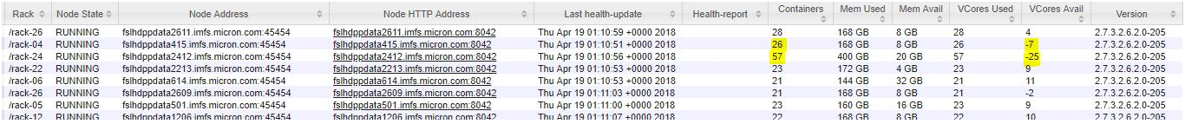
Hadoop Admins Updates
#1 Yarn: CPU Scheduling is disabled - This was attempted but ran queues out of space.
Default resource calculator (DefaultResourceCalculator) resources are allocated based on memory alone. Meaning yarn will just ignore the allocation CPU resources and you will see the symptoms as below
Lars strongly recommended enable this feature and compare the resources in scheduler. More details URL
Jira ticket for Hadoop Admins: JIRA BDOPS-319
Summary:
While CPU Scheduling is disabled, only memory is taken into Yarn Resources consideration. Meaning jobs can use all the available memory with 4GB per container size but the vcores will have negative value or overhead.
While CPU Scheduling is enabled, both CPU and memory are taken into Yarn Resources consideration. In order to optimize cluster resources with achievement 1:1 ratio to for 4GB per container, we need to add about 180 datanodes to cluster else CPU will become the bottleneck.
Hadoop admin decided to disabled CPU scheduling and adjusted the minimum container size from 4GB to 12GB which is the best fit of container size = total memory / total vcores. Conclusion, CPU scheduling is good if we have good ratio fit in CPU and memory.

Slide 36
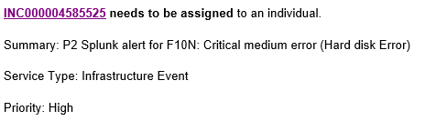
Hadoop Admins Updates
#2 Hardware: Monitoring on low performance HDD – Currently are using existing patrol alerts to Unix admins hard drives are replaced when they fail
Background: During the troubleshooting session with Lars, he found a bad hard drive causing slowness while the application was reading / writing data. Normally we will receive hard drive failure alert when the disk totally failed but for low performance disk (says performance only have 6.4kb/sec) will not able to get notify.
Lars recommended to monitor each of the disk performance and get alert for replacement if performance is low.
Summary:
Added monitoring script on Splunk dashboard. Remedy will auto generated once slowness detected and relevant teams will arrange for disk replacement. Below is the example:

Slide 37
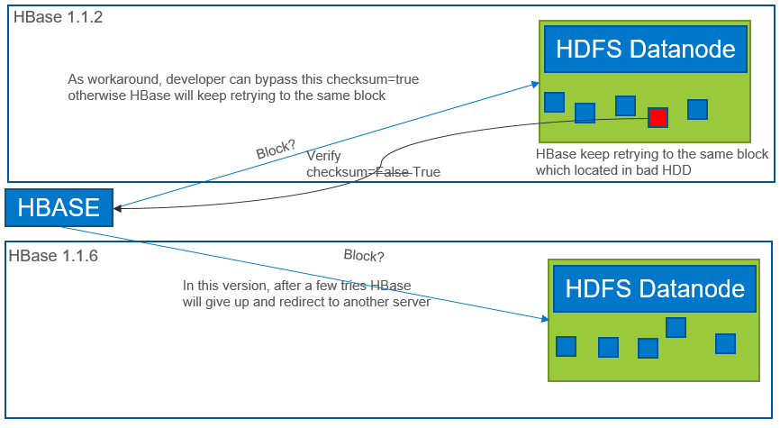
#3 HBase: Bug in Apache HBase 1.1.2 – Patch included in our build
Background: In HBase 1.1.2, HBase will keep retrying access to the block that located in a low performance HDD and this is the reason why users were having intermittent slow issue. This is an known bug HBASE-11625 which fixed in HBase 1.1.6. In this version HBase will auto diagnostics and redirect to others region servers.
Summary: As low performance HDD will be replace once detected. This issue had been resolved.

Slide 38
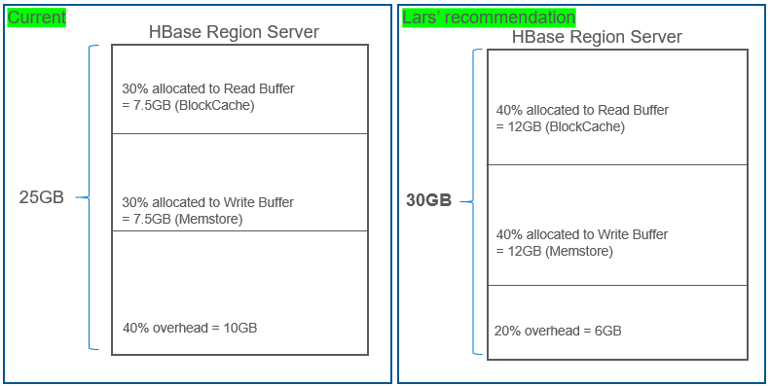
#4 HBase: Memory – Sesi will test settings
Lars recommendations: Buffer size (Read & Write) can set as default 40% instead of 30% Region Server memory can increase from 25GB to 30GB (max) due to ‘java blackhole’ Flush size to 128MB
Lars explained the reasons why given these recommendations. He also mentioned if current settings are sufficient then is not require to change and just bear in mind.
Lars recommended this based on Grafana dashboard. We have enough resources if we increase to 30GB, menstore looks good in grafana but blockcache was reaching 7.3GB. Also, we can based on read & write workload to determine how many recourses should allocate in read & write.
How?
Look at Blockcache & Memstore utilization and tweak memory accordingly
e.g. if Memstore is usually only 20% full but Blockcache is at capacity you could decrease the former and increase the latter
My own study on hortonworks

Slide 39
#5 HBase: BucketCache – Currently not set to take advantage of this setting. Will need to investigate using NVMe caching.
Background:
Currently bucketcache is off by default. This is depending on users’ apps behavior.
This is a very good example that I found in Hortonworks articles why enable bucketcache.
Enabled BucketCache
Hitting ‘JVM Heap & GC’
OFF Heap
Client
Blockcache
Memstore
No GC
Rest….

Slide 40
#6 HBase Monitoring – Graphs are available in Grafana Admin team currently uses them
These are the metrics that Lars recommended us for monitoring to ensure HBase stability
All *Queues
Compaction Queue
Flush Queue
RPC Queue
Operation Latencies
Handler Usage/Count
Blockcache size/eviction rate
Memstore size
#7 HBase throttle requests – already included in our hbase build
​​https://issues.apache.org/jira/browse/HBASE-13205 http://blog.cloudera.com/blog/2015/05/new-in-cdh-5-4-apache-hbase-request-throttling/ https://blog.cloudera.com/blog/2014/12/new-in-cdh-5-2-improvements-for-running-multiple-workloads-on-a-single-hbase-cluster/ https://docs.hortonworks.com/HDPDocuments/HDP2/HDP-2.6.1/bk_data-access/content/ch_hbase-quota-management.html​
Per User, Namespace or Table

Slide 41
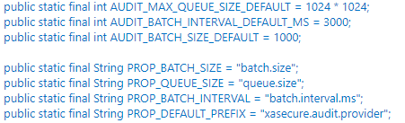
#8 Log Analyze
Tips from Lars: - good suggestions to be used when troubleshooting
From the logs’ messages (warn/error/fatal) and look at the codes (https://github.com/hortonworks) of HDP stack.
java.lang.IllegalStateException: Queue full so the properties look like prefix + property: e.g. xasecure.audit.provider.batch.size Lars's comment: Seems like you might want to increase the batch size and maybe decrease the interval. I wouldn't change the queue size Reference: Click here for more details
ERROR - Ignoring CompletedProcedureCleaner exception: null​ Lars's comment: Fixed in later versions, this can be safely ignored I think Reference: HBASE-19756 - Click on the patch for more details
Slow BlockReceiver write data to disk cost , Slow BlockReceiver write packet to mirror took 653ms (threshold=300ms), Slow manageWriterOsCache Reference: HDFS-10303 (Please look into the patch) – not available until 3.0

Slide 42
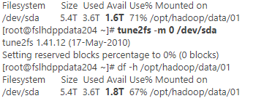
#9 HDFS Balancer vs Hbase – following Lars suggestions
Background:
How to prevent data locality destroy on HDFS Balancer event?
Lars's comment: This feature is available in our current version and pay attention on the details of HBASE-15332 documentations References: HBASE-15332 -Exclude /HBase while running balancer
#10 Optimize disks spaces – will work with architects to verify
Background:
Use 'tune2fs' unix tool for change/modify tunable parameters on ext4 type filesystem. We had reserved 5% space for each of the disks in datanodes. Meaning 5% of 6TB = 300GB per disk reserved, so (300GB*12)*256=921,600GB additional free spaces if we have reserve to 0%
How:

Slide 43
#11 Optimize HDFS Spaces - will work with architects to implement
Background:
1​00 GB reserved for non HDFS use per drive = 100 = 300.000GB ~300TB, could probably safely lower to 50GB or so. Reason: Current setting for 'Reserved space for HDFS' is set to ​​107374182400​ bytes, can set to 50GB for more spaces.

Slide 44
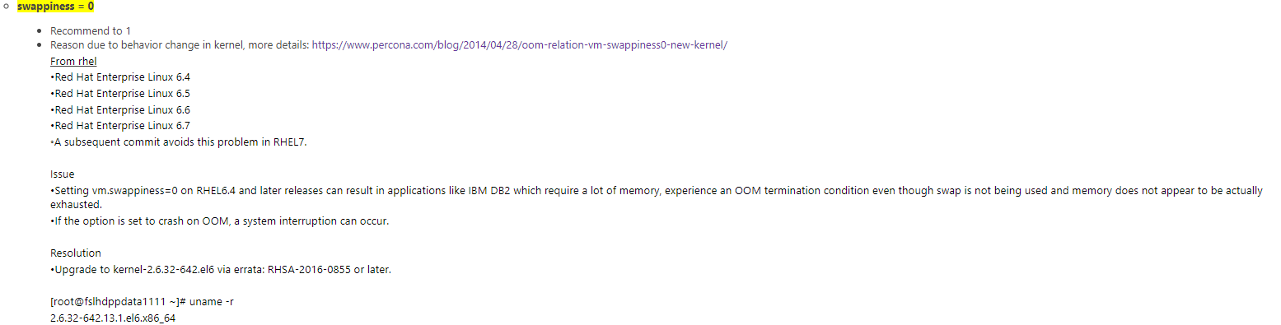
To be Confirm… doubled memory and will be upgrading all systems to Rel 7 by 2/2019

Slide 46
High Level Explanation of HBASE Architecture

Slide 47
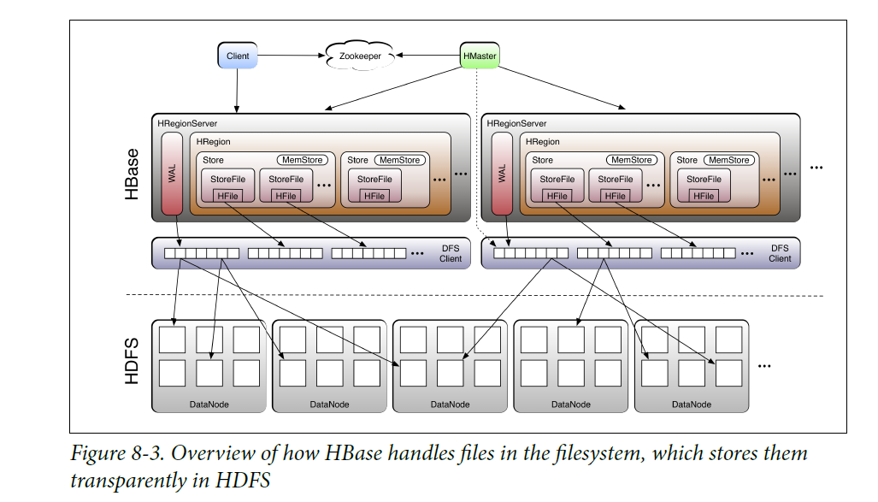
Detailed Architecture

Slide 48
Detailed Architecture
How HBASE works and communicate
Step 1: Client establish connection with ZooKeeper ensemble

Slide 49
Detailed Architecture
How HBASE works and communicate
Step 2: Query the reported hbase:meta server and retrieve region server location which contains the row key that client is looking for

Slide 50
Detailed Architecture
How HBASE works and communicate
Step 3: Client make contact with the HRegionServer (a.k.a Region Server)

Slide 51
High Level Explanation of HBASE Put()

Slide 52

Detailed Architecture
How HBASE works and communicate
How does a Put() work exactly?

Slide 53
Detailed Architecture
HBase Put()
Step 1: Client pass relevant information to the HRegionServer (a.k.a Region Server) and to the HRegion residing in the HRegionServer (a.k.a Region)

Slide 54
Detailed Architecture
HBase Put()
Step 2: Write data to WAL (Write Ahead Log). Why?

Slide 55
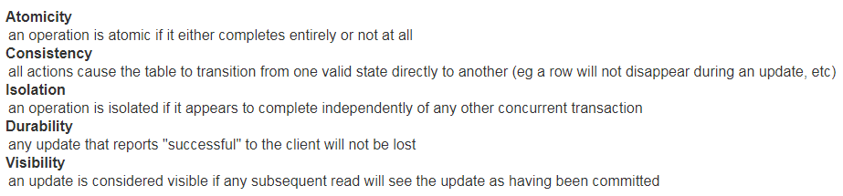
Detailed Architecture
HBase Put()
Write Ahead Log (WAL):
WAL contains a sequential number which allows for ACID guarantees

Slide 56
Detailed Architecture
HBase Put()
Step 3: Write data to Memstore. If memstore is full, then data is flushed to disk.

Slide 57
Details Explanation of HBASE MemStore Flushes

Slide 58
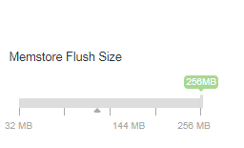
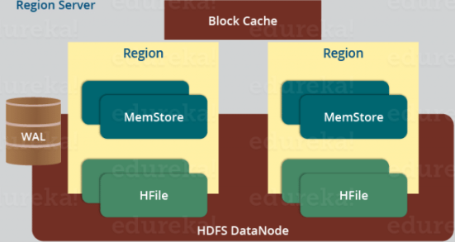
Detailed Architecture
Memstore Flush (Critical Parameters)
Each Column Family will have its own memstore.

Slide 59
Detailed Architecture
Memstore Flush (Critical Parameters)
hbase.hregion.memstore.flush.size
When memstore exceed this size, it will be scheduled for flushing
hbase.hregion.percolumnfamilyflush.size.lower.bound
If per-column family flushing is enabled, this lower bound triggers store flush

Slide 60
Detailed Architecture
Memstore Flush (Critical Parameters)
Before the maximum threshold is attained, flush can occurs under these situation by the Periodic Memstore Flusher:
Edit Count
Elasped Time

Slide 61
Detailed Architecture
Memstore Flush (Critical Parameters)
Per column family flushing
Memstore sort the Key values pairs in a lexicographical manner.
Writes are places sequentially on disk → Reduce movement of disk read-write
Trailer (pointer which points to the Hfile’s meta block) is written at the end of the commited Hfile
Trailer contains information and bloom filters.

Slide 62
Details Explanation of HBASE Compaction

Slide 63
Detailed Architecture
HBASE Compaction
Compaction Objective:
Reduce number of files that NameNode managed
Reduce the probability of rows being spread out in different Hfile
Minor Compaction:
Combining smaller Hfiles into Large Hfiles
Major Compaction:
Combining multiple StoreFiles into a Single StoreFile

Slide 64
Should I keep my row keys / column qualifiers as short as possible?

Slide 65
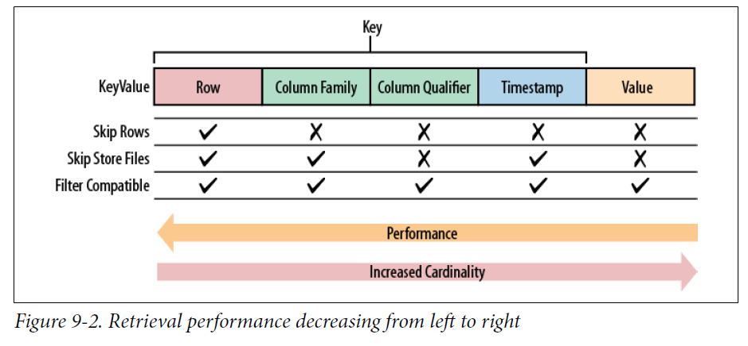
HBASE Insights
It depends
HBASE Design (Question 3)
A short row key is going to be useless if we need to do many operations to retrieve the data.
A long column qualifiers can be shortened by using data block encoding
When designing, keep in mind of this:

Slide 66


HBASE Insights
HBASE Ingestion (Question 1)
Put()
Each operation is basically a remote procedure call.
Which is faster?
Client
Server

Slide 67
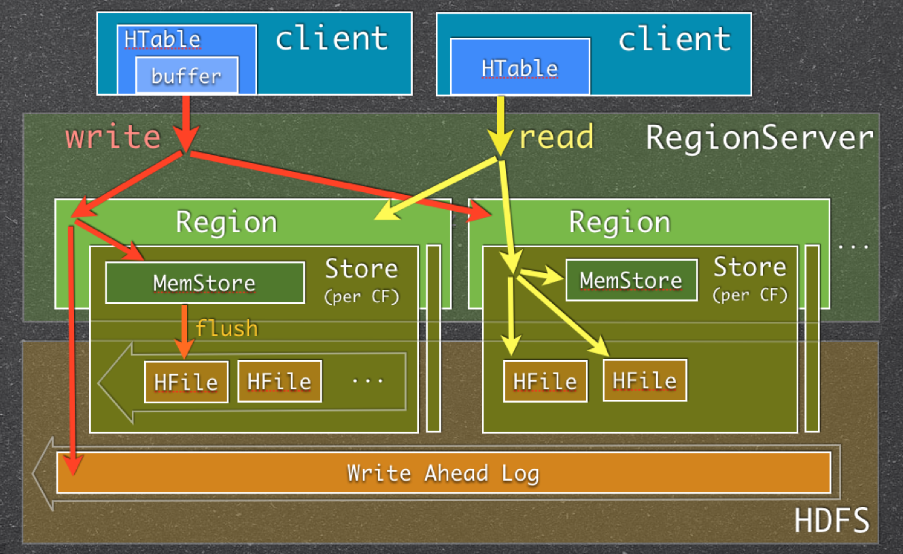
HBASE Insights
HBASE Ingestion (Question 1)
Buffer Mutator
Collect all the Put() in one RPC call

Slide 68
HBASE Insights
HBASE Ingestion (Question 1)
Bulkloading
Produce a Hfile at the end of the Mapreduce script
Load each Hfile into each region via the Regionserver serving it
Avoid excessive flush() from memstore

Slide 69
HBASE Insights
It depends
HBASE Ingestion (Question 1)
Should we always use bulkload to avoid flushes?
1.

Slide 70
Filtering in client / server? Which is faster?

Slide 71
HBASE Insights
HBASE Extraction (Question 1)
Assuming you have a known row key and a known set of column qualifiers you wish to extract:
Is it more optimal to load the ResultSet into Client side and perform the filtering?
Or is it faster to apply a set of Column Qualifers Filters at the server side?
Method 1 (Hash Map):
For each row key, iterate N column qualifiers in the ResultSet:
Check whether the column qualifier exist in Hash Map containing a known set of column qualifiers (Assuming no hash collision O(1))
Method 2 (Column Qualifier Filter / Multiple Prefix Filter): ?

Slide 72
HBASE Insights
HBASE Extraction (Question 1)
Assuming you have a known row key and a set of column qualifiers you wish to extract:
Is it more optimal to load the ResultSet into Client side and perform the filtering?
Or is it faster to apply a set of Column Qualifers Filters at the server side?
Benchmark Results for ~ 3million gets(); each row key contains 5 K column qualifiers
Lesson Learnt: Before developing filtering logic on client side, search the API documentations for server-side HBASE API
Method 1: Using HASHMAPs | Method 2: Using Column Prefix Filter | Method 3: Using Multiple Column Prefix Filter
>15 mins | ~750 – 900 s | ~400 – 500 s

